Slide 1
Unit 6
HCI MODELS AND THEORIES

Slide 2
Syllabus
Goal and task hierarchy model,
Linguistic model,
Physical and device models,
Cognitive architectures,
Hierarchical task analysis (HTA),
Uses of task analysis,
Diagrammatic dialog design notations,
Computer mediated communication,
Ubiquitous Computing,
Finding things on web Future of HCI.

Slide 3
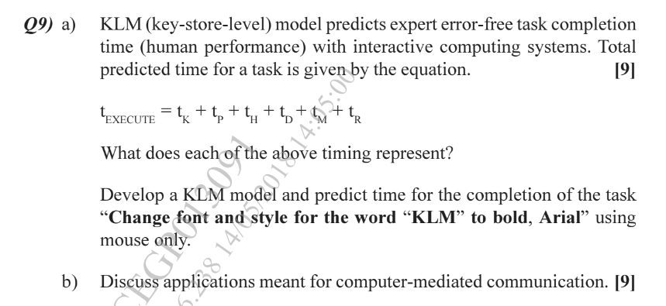

Slide 4
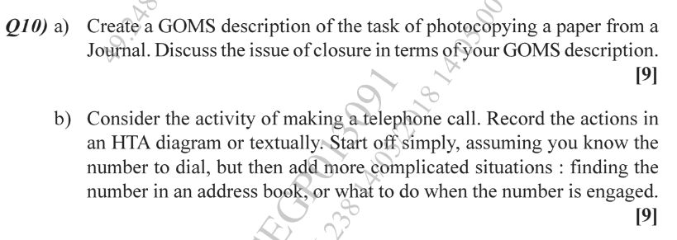
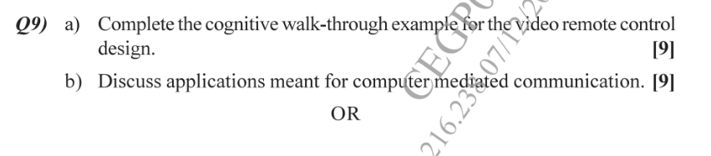

Slide 5
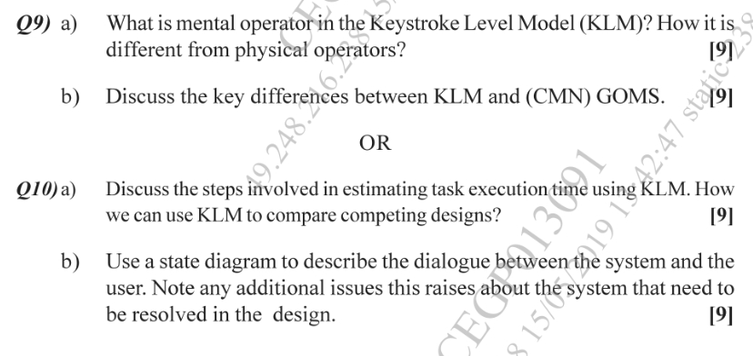

Slide 6
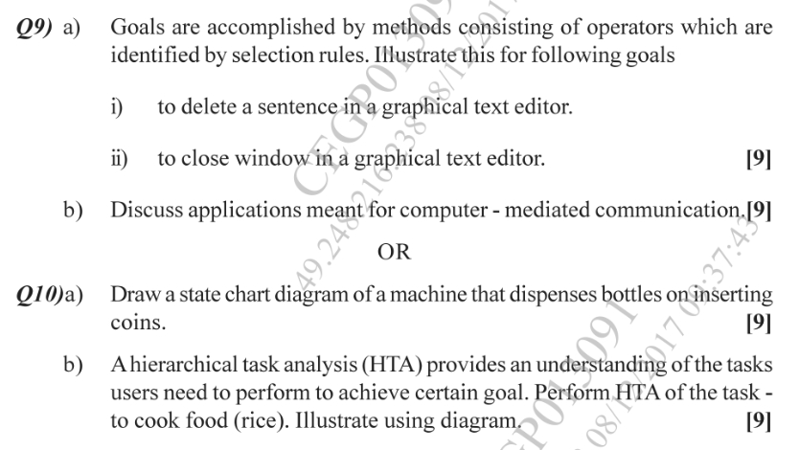

Slide 7
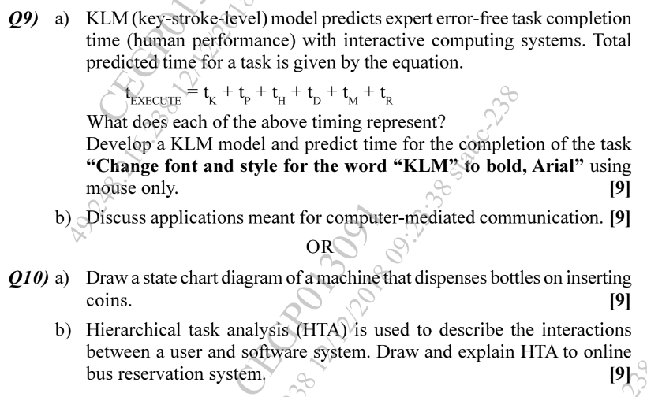

Slide 8
